Slide 1
COS 102: INTRODUCTION TO PROBLEM SOLVING (UNIT 1)
MODULE 4 : COMPUTING AREAS OF PROBLEM
UNIT 1: BASIC COMPUTING AREAS OF PROBLEM.

Slide 2
Learning Objectives :
The learning objectives of studying basic computing areas related to search and sorting algorithms typically encompass several key goals:
Understanding Algorithms: Gain familiarity with various search and sorting algorithms, including their principles, advantages, and limitations. Algorithms like linear search, binary search, bubble sort, insertion sort, selection sort, merge sort, and quick sort are commonly studied at this level.
Algorithm Analysis: Learn how to analyze algorithms in terms of time complexity (Big O notation) and space complexity. Understand the implications of different complexities on algorithm performance and scalability.
Implementation Skills: Develop the ability to implement search and sorting algorithms in programming languages of choice. Practice translating algorithmic descriptions into executable code, paying attention to correctness and efficiency.
Comparative Analysis: Compare and contrast different search and sorting algorithms based on their performance metrics (e.g., average-case, best-case, worst-case scenarios). Understand when and why certain algorithms are preferred over others in specific contexts.
Problem Solving Application: Apply search algorithms to find elements in data structures (e.g., arrays, lists, trees) efficiently. Apply sorting algorithms to organize data in ascending or descending order for easier retrieval and manipulation.
WHAT IS SORTING AND SEARCHING ALGORITHMS

Slide 3
Overview:
PROBLEM SOLVING
There are many problems we encounter in computing (i.e sorting, searching, string processing, graph, combinatorial, geometric and numeric e.t.c). Out of these problems, some have attracted particular attention from researchers. The interest has been motivated either by the problem's practical importance or by some specific characteristics making the problem an interesting research subject. In this section, we look at most important and common computing problem types in computing which is Sorting and Searching
SOLVE A COMPUTER PROGRAM
UNDERSTAND THE PROBLEM
ANALYZE THE PROBLEM
DEVELOPING THE SOLUTION
CODING AND IMPLEMENTATION

Slide 4
Sorting: Sorting problem involves rearranging the items of a given list in ascending or descending order. Such sorting can be carried out on lists of numbers, characters from an alphabet, character strings, and most importantly records.
What is a sorting ?

Slide 5
Examples of records include student records, library user records, employee records etc. Over the years, large number of sorting algorithms has been invented by different researchers. Some of them we shall encounter in future modules include mergesort, bubble sort, insertion sort etc.
The importance of sorting is that it enables faster solution to some other problems like searching. It also enables user to analyze their data.

Slide 6
A
B
A
D
C
Classical example of sorting
A
C
B
D

Slide 7
4
2
3
4
Classical example of sorting
ASCENDING
1
2
3
4

Slide 8
4
2
3
4
Classical example of sorting
DESCENDING
4
3
2
1

Slide 9
Searching: Searching problem entails finding a given value, called a search key, in a given set. Just like sorting, many searching algorithms exit among which are: sequential search, binary search etc.
Searching algorithms are typically used to find a specific item or element within a collection of data. While searching algorithms themselves don't deal directly with images (since images are usually composed of pixels and represented in a different format), they can be applied in scenarios where images are stored or indexed in a structured manner.
WHAT IS SEARCHING?

Slide 10
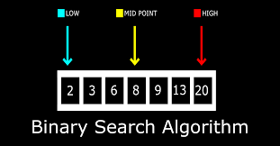
CLASSICAL EXAMPLE OF SEARCHING
Binary Search (for sorted data):
Algorithm: Binary search is used on sorted data. It divides the search interval in half repeatedly until the target element is found or determined to be absent.
Application: If your list of images is sorted (e.g., alphabetically by filename), you can use binary search for faster retrieval.
Example: Consider a sorted list of filenames:
sorted_image_files = ["beach.png", "cat.jpg", "dog.png", "family_photo.jpg", "landscape.jpg"]
You want to find "family_photo.jpg". Binary search would start in the middle ("dog.png"), compare it with the target ("family_photo.jpg"), and decide to search the left or right half based on alphabetical order, significantly reducing the number of comparisons needed compared to linear search.

Slide 11
Example: Consider a sorted list of filenames:
sorted_image_files = ["beach.png", "cat.jpg", "dog.png", "family_photo.jpg", "landscape.jpg"]
You want to find "family_photo.jpg". Binary search would start in the middle ("dog.png"), compare it with the target ("family_photo.jpg"), and decide to search the left or right half based on alphabetical order, significantly reducing the number of comparisons needed compared to linear search.
Application: If your list of images is sorted (e.g., alphabetically by filename), you can use binary search for faster retrieval.

Slide 12
Searching algorithms are typically used to find a specific item or element within a collection of data. While searching algorithms themselves don't deal directly with images (since images are usually composed of pixels and represented in a different format), they can be applied in scenarios where images are stored or indexed in a structured manner.
Example: Suppose you have a list of image filenames or tags:
image_files = ["cat.jpg", "dog.png", "landscape.jpg", "family_photo.jpg", "beach.png"]
You want to find if the image "family_photo.jpg" exists in this list. Linear search would iterate through the list until it finds "family_photo.jpg" or determines it's not present.
CLASSICAL EXAMPLE OF SEARCHING

Slide 13
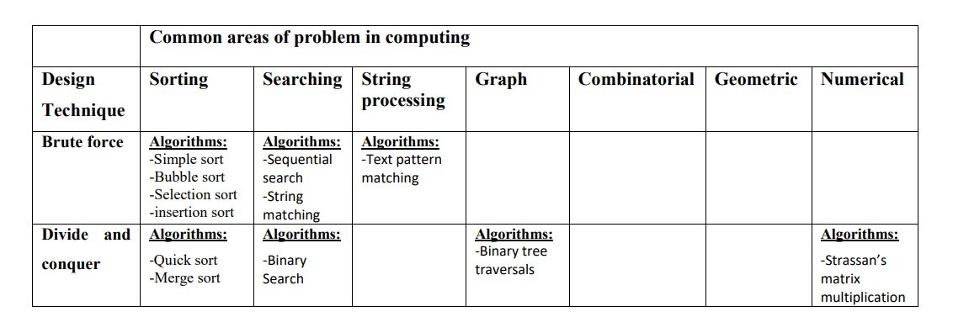
THE CLASSIFICATION OF ALGORITHMS TO DESIGN TECHNIQUE AND COMPUTING PROBLEM AREAS

